Slide 1


LIBRARY MANAGEMENT SYSTEM
JAVA MINI PROJECT
Done by
Arun Reghunathan
Md Aamir
Nithin N Sibi

Slide 2
PROJECT OUTLINE
INTRODUCTION
TOOLS USED AND MODULES
WORKING OF THE APPLICATION
DATA ANALYSIS

Slide 3

INTRODUCTION
A library management system is an essential tool that helps in the efficient organization and management of a library's resources. In this project, we will be developing a library management system in Java using command line interface. The system will cater to four different types of users - admin, user, librarian, and clerk.
The admin will have access to the system's administrative functionalities, such as adding and removing Librarian and clerks, managing library resources. The user will be able to browse the library's collection, search for resources, and check the availability of resources.
The librarian and clerks will be responsible for managing the library's inventory, such as adding and removing books, managing borrowers' records, and handling overdue books. Finally, the clerk will have the responsibility of issuing and returning books, managing borrowers' records, and handling fine payments.
This library management system will provide an intuitive and user-friendly interface that simplifies the library's daily operations. By implementing this system, librarians can efficiently manage the library's resources, while users can easily access the library's collection and borrow books seamlessly.

Slide 4
TOOLS USED AND MODULES
This project is done on Apache Netbeans IDE which is connected to Derby Database
The second phase in use case analysis is to identify the tasks that each actor will have to perform with the system after identifying the players. Each activity is referred to as a "use case" since it illustrates a specific use of the system.
In other words, only those use cases are listed that actors will need to do when they are using the system to solve the customer’s problem.
This Project i.e. Library Management System has 4 modules/Actors namely
Administrator(Admin)
Librarian
Clerks
Borrower(User)

Slide 5

MODULES/ACTORS
The Administrator can add/remove clerks or librarian. He can also view all the issued books along with viewing all the books in the library.
The Librarian has many functions out of which some of the functions are adding a new book, deleting a book, updating the info about a previously added book, adding a borrower or deleting a borrower.

Slide 6

MODULES/ACTORS
Clerks are basically a help to the Librarain as the librarian alone cannot handle a lot of students. Clerks have functions which are mostly similar to the librarian like Check out an item for a borrower Check in an item that has been returned, Renew an item, Record that a fine has been paid, Add a new borrower etc.
The Borrower i.e. the User has functionalities like Search for items by title/author/by subject, Place a book on hold if it is on loan to somebody else, Check the borrower’s personal information and list of books currently borrowed.

Slide 7
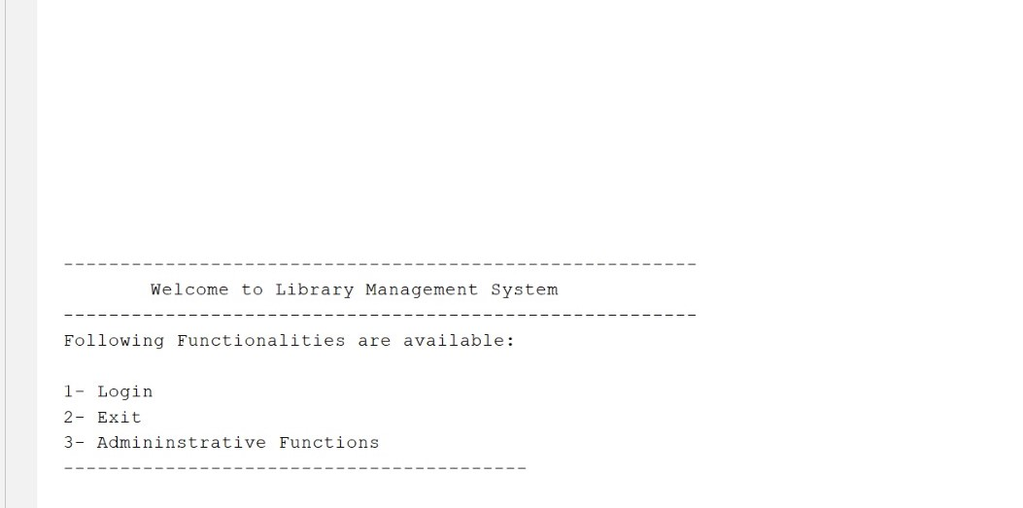
WORKING
This is the main page of Library Management System

Slide 8
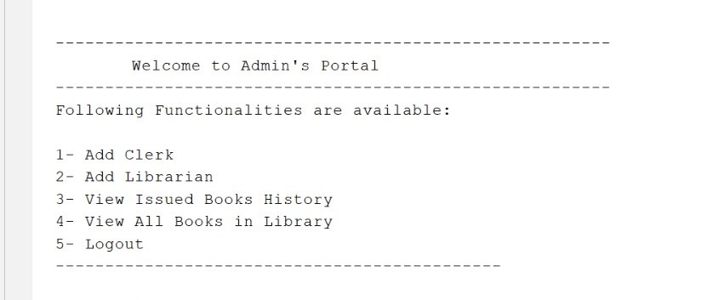
WORKING
This is the Administrator’s page

Slide 9
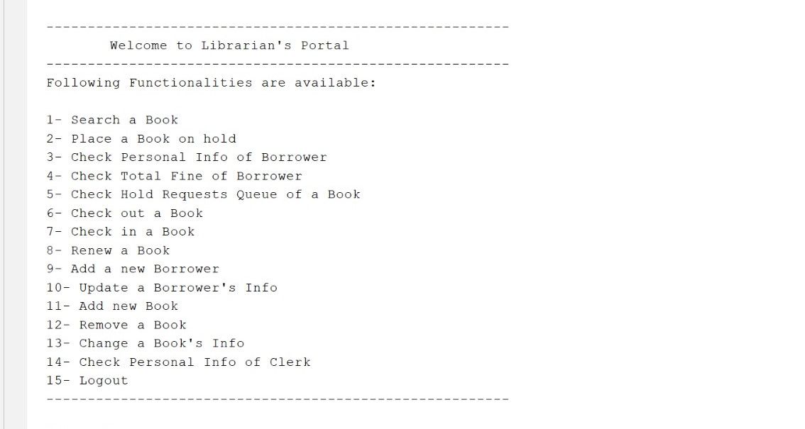
WORKING
This is the Librarian’s Page

Slide 10
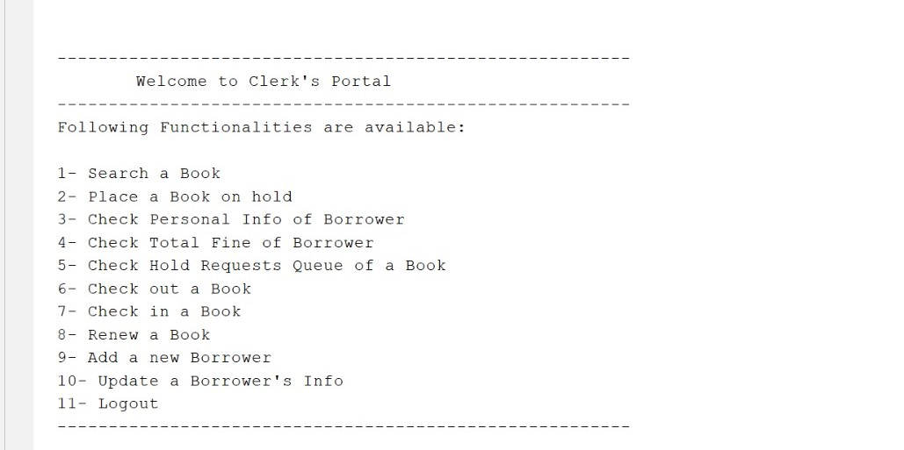
WORKING
This is the Clerk’s Page

Slide 11
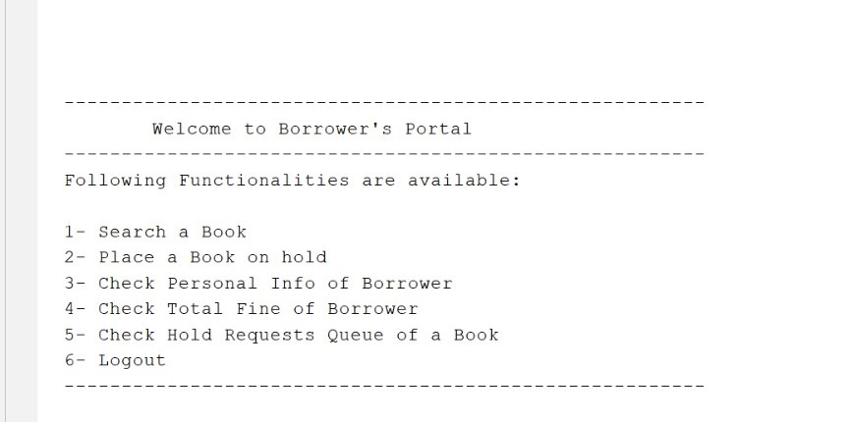
WORKING
This is the Borrower’s Page

Slide 12
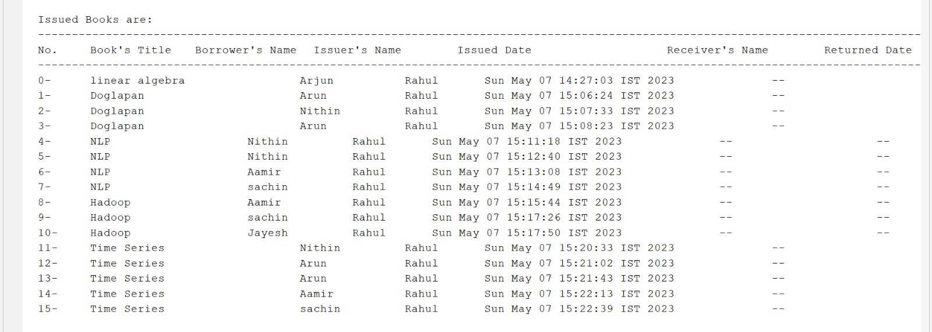
DATA ANALYSIS
We have Analysed the data which was given as input to Library Management System and gained some insights. So the given data below shows the books that were issued , that is the books that were borrowed by various borrowers.

Slide 13
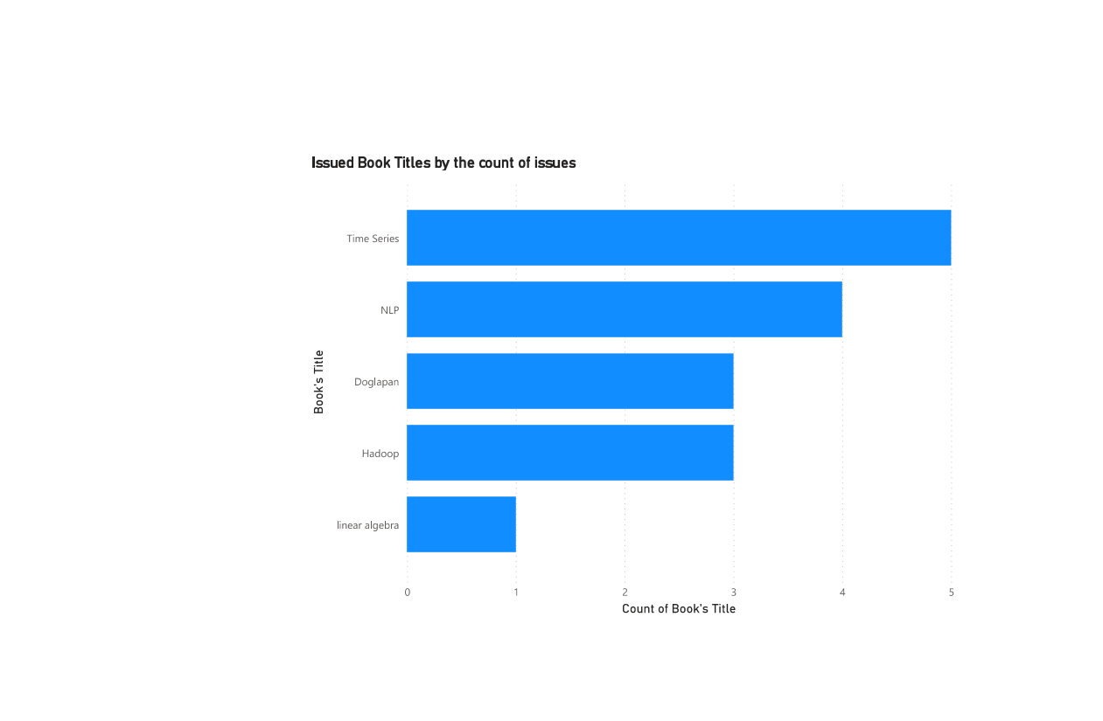
DATA ANALYSIS
This Bar chart clearly shows that the book with title Time Series has the most number of issues while the book Titled linear algebra has the least Number of issues.

Slide 14
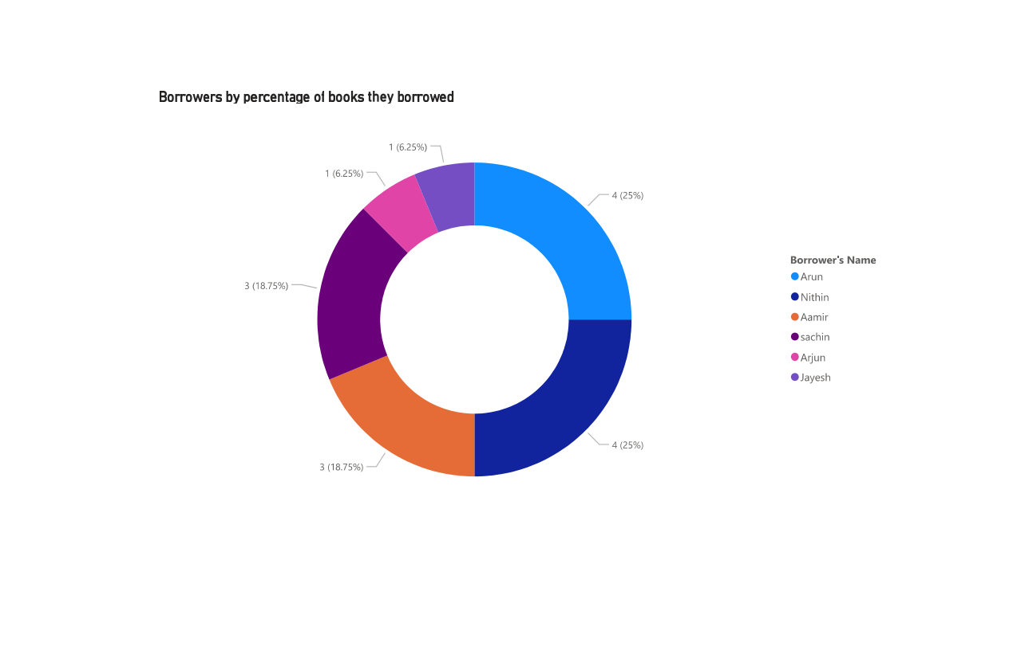
DATA ANALYSIS
This donut chart clearly shows that the borrowers named Nithin and Arun has borrowed the most percentage of books while the
Borrowers named Arjun and
Jayesh has borrowed the least
Percentage of books from the
Library.

Slide 15


